Slide 1
Red Apple 2011
Integrated campaign
Russia Open
CREATIVITY
Championship

Slide 2
Epigragh
«It is like coming to World Football Championship and losing all matches»
Johan Jervøe, Intel Corporation
About oneself and the Cannes Lions 2011.

Slide 3
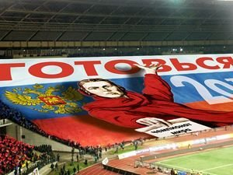
Product:
Red Apple – annual Moscow International Advertising and Marketing Festival
Objective:
to stimulate Russian agencies to participate in the festival

Slide 4
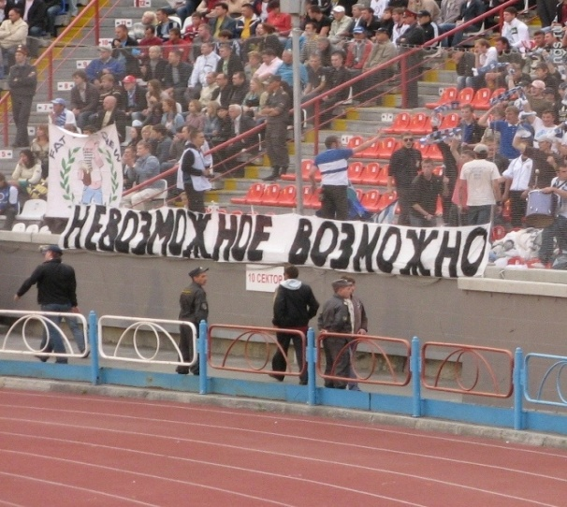
Insight :
Due to AKAR rating festival activity turned into an ambitious battle of agencies. One of possible consequences of such an intense rivalry is the number of awards Russia got at the Cannes Lions Fest this year. It equaled the total amount of prizes for all the previous years all previous years.

Slide 5
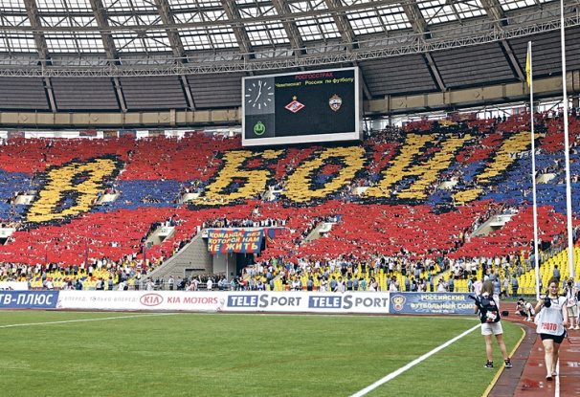
Solution:
interpretation of the Festival 2011 as an awesome competition among agencies which for Russian agencies is also a true DERBY
Red Apple 2011 –
Russia Open
CREATIVITY Championship

Slide 6
Slogan:
«Unless cool –too hard for you»
Promises both a fair chance to win and an uncompromising battle (among the best of the best in advertising world)

Slide 7
Integration:
concept that artistically demonstrates the link between sport and advertising was implemented in many formats (OOH, print, radio, ТV, internet banners, web- site, souvenirs etc.)

Slide 8
Print, OOH, Internet banners

Slide 9
TV story board

Slide 10
Radio Script
Radio spot is done as parody of ring announcer of big boxing tournament . We hear the voice of the fan crowd , coach giving the last instructions: Come on boy!! Let’s do it..» , gong sound…
They’ve been practicing on their clients for the whole year!
They are unbeatable in advertising and marketing!
Who will win the a-a-a-a-a-a-bsolute champion title?
Final battle – 29-30 September – ‘Swiss Hotel Krasnye Kholmy’ Arena
Follow the course of CREATIVE Championship Red Apple on
www.festival.ru

Slide 11
Concept for
deadline communication
Receive of Serve till 20.08.11
(double meaning: ‘serve’ means also ‘application’ in Russian )

Slide 12
Concept for tickets

Slide 13
Concept for tickets

Slide 14
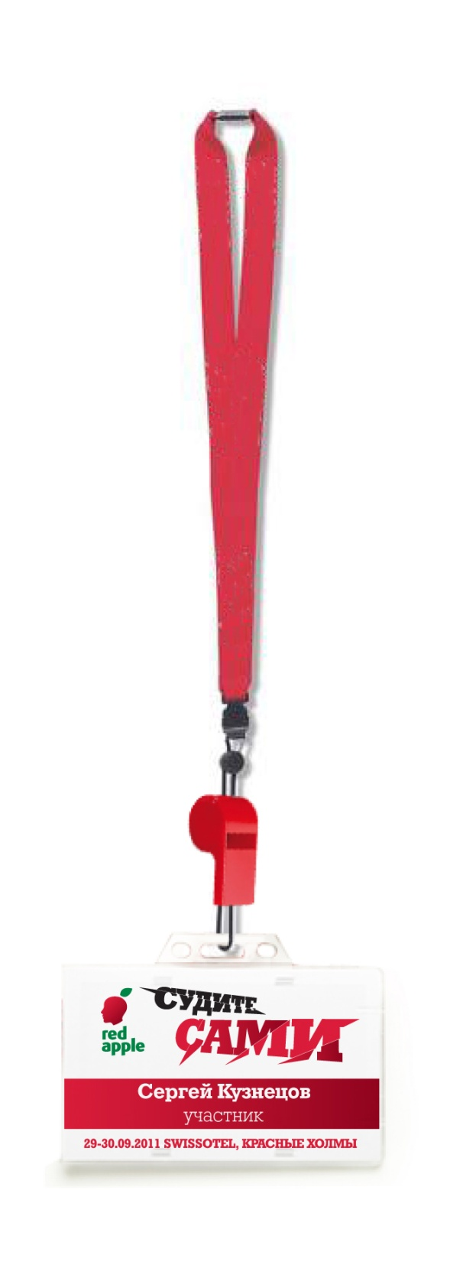
Badge -whistle for the Jury.

Slide 15
Badge -medals for Festival Organizational Committee

Slide 16
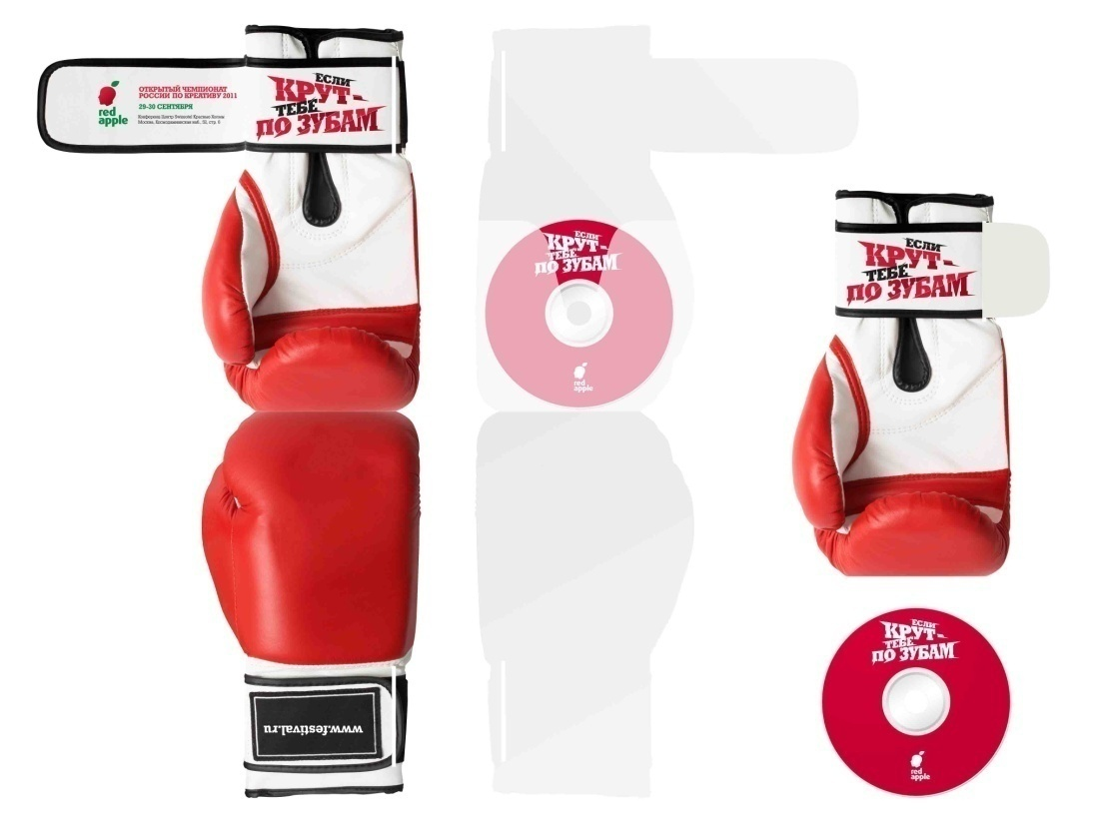
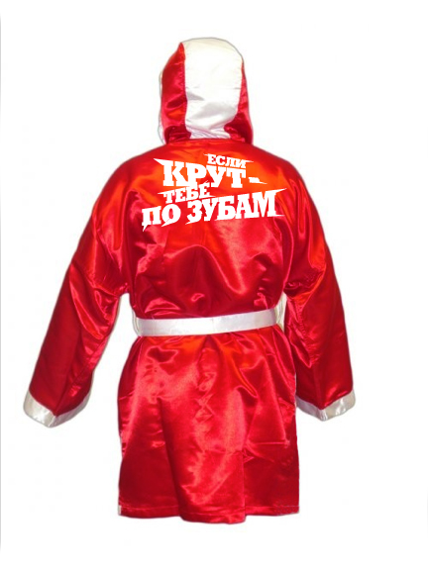
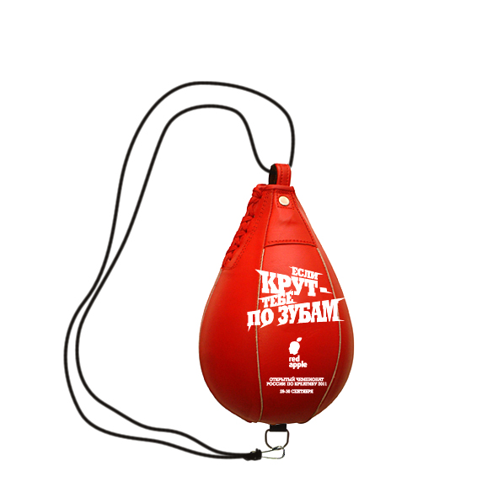
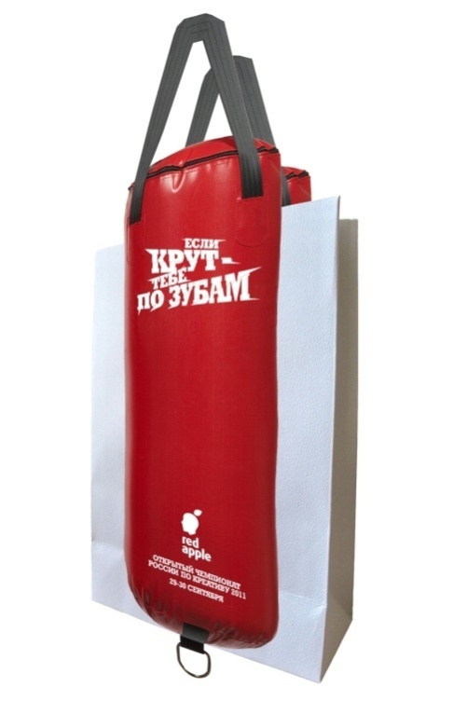
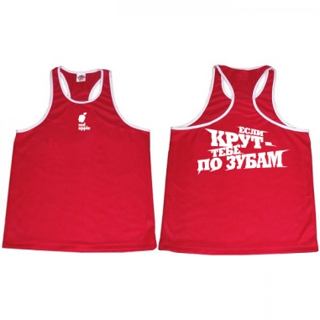
Souvenirs
CD Cover.
Boxer
dressing gown
Bag
Punching bag
Tank tops

Slide 17
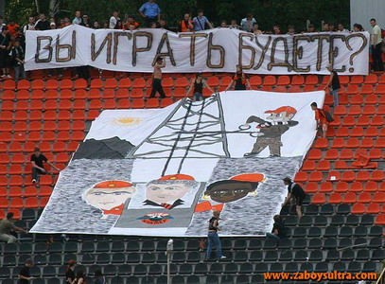
Shall you play?

