Slide 1
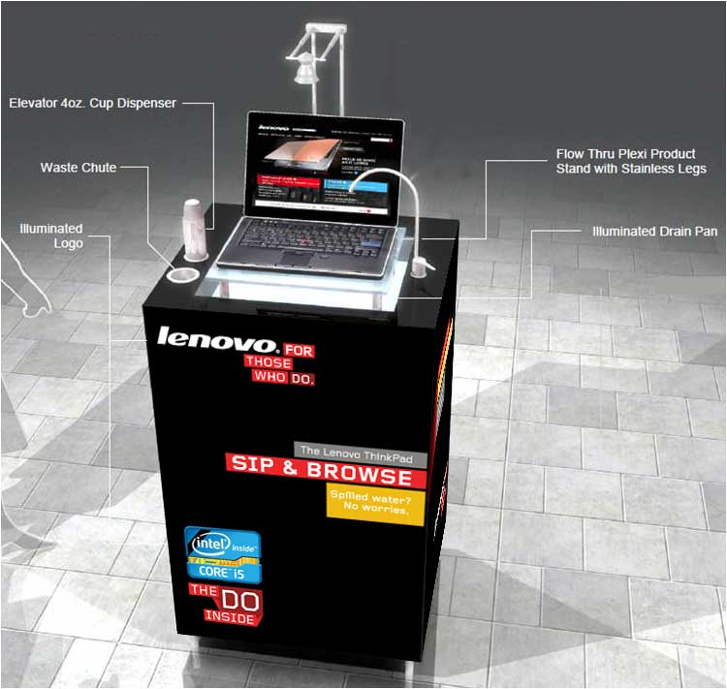
CREATIVE IDEAS:
Water Cooler with our notebook to demonstrate spill-proof keyboards

Slide 2
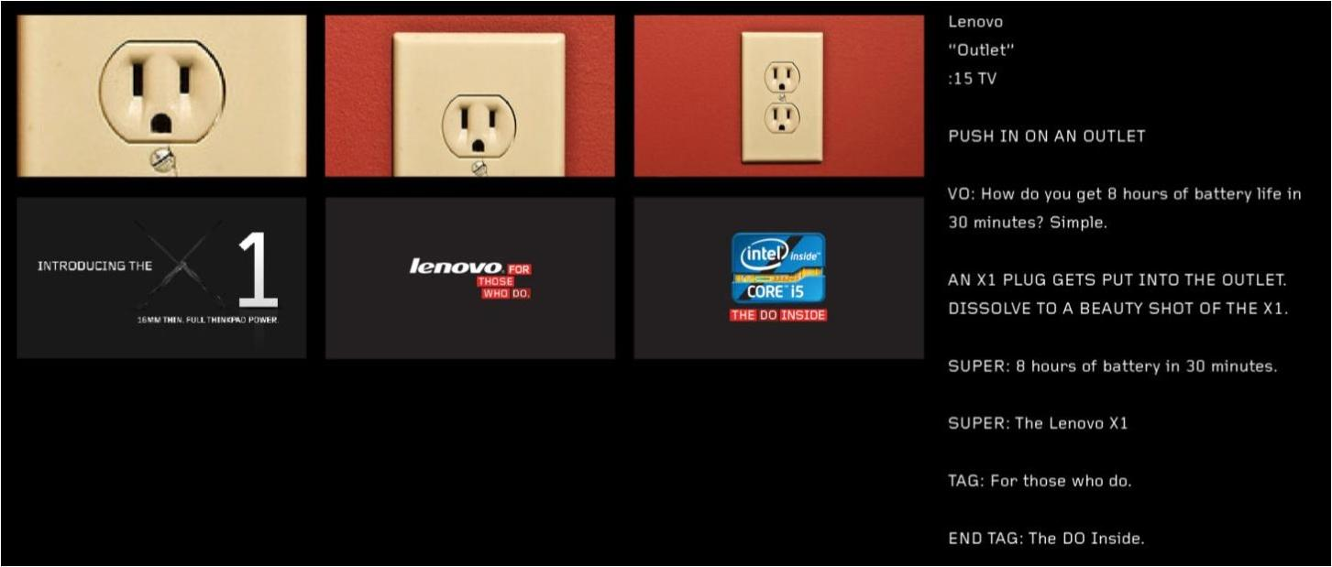
CREATIVE IDEAS: WALL PLUGS

Slide 3
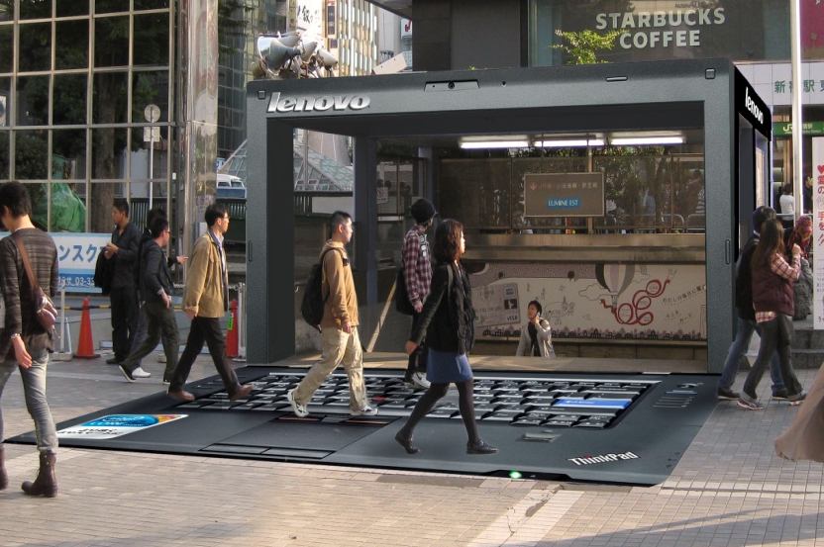
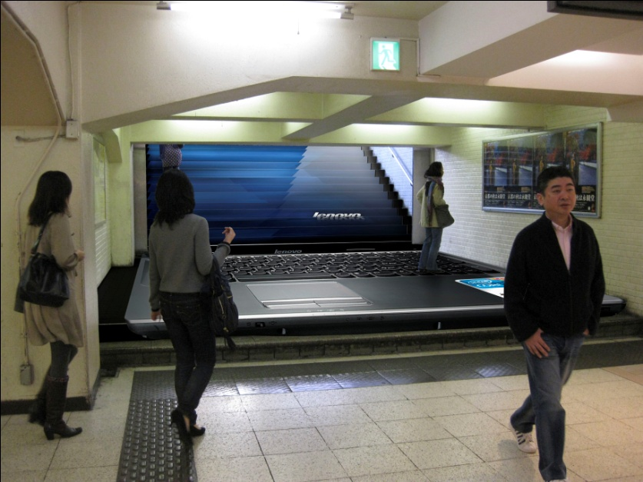

Slide 4
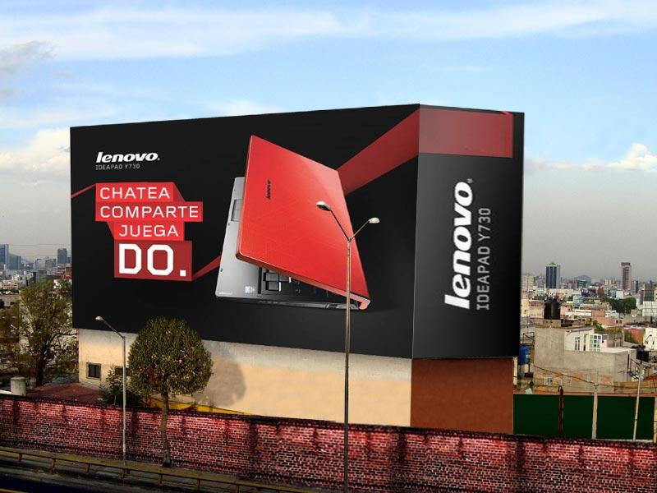
CREATIVE IDEAS: BUILDING WRAPS

