Slide 1
И такое бывает…
Любопытные практики мобильного маркетинга
Юрий Берченко
Руководитель отдела по работе с ключевыми клиентами в секторе ритейл
Google Россия

Slide 3
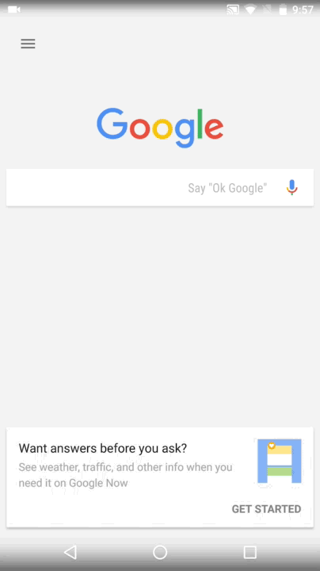

Slide 4
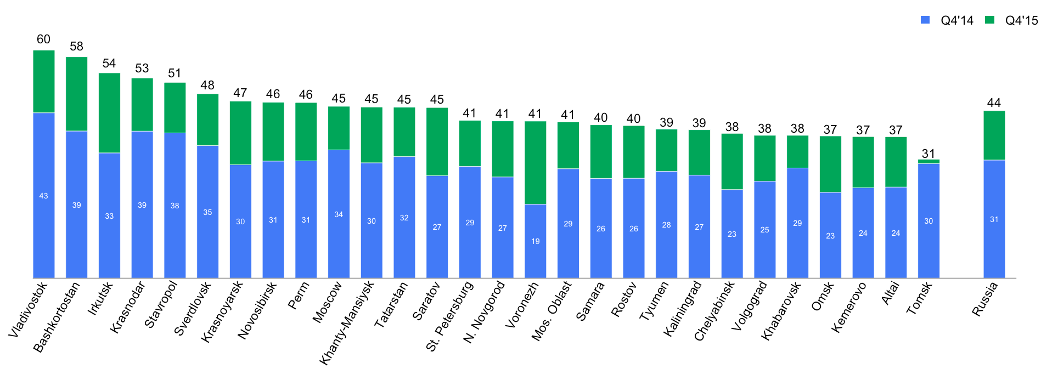
In Russia share of mobile queries on Google is close to 50%
% of mobile queries depending on region

Slide 7
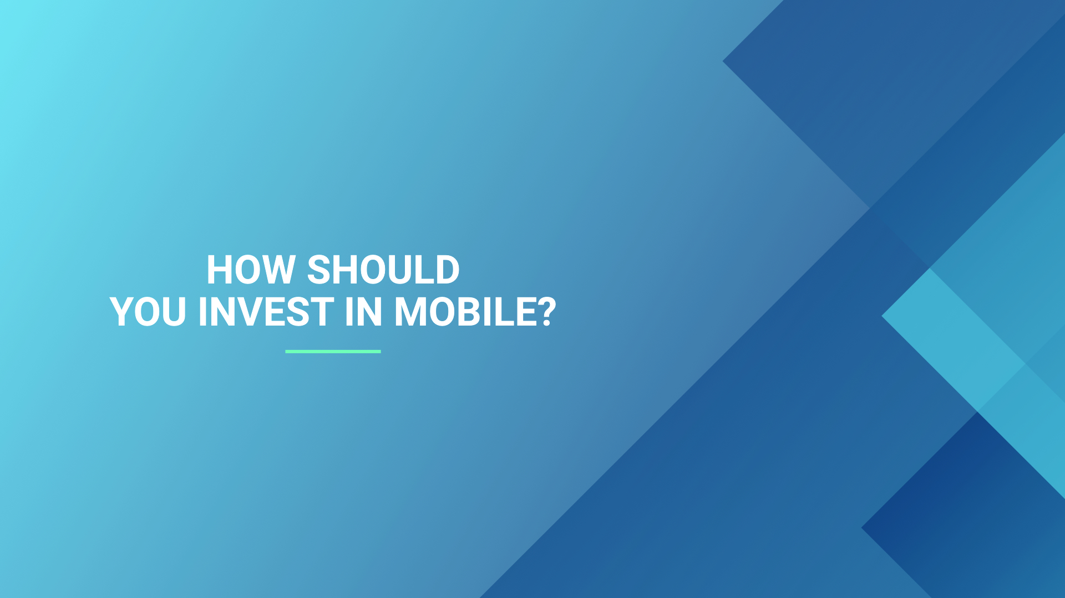

Slide 10
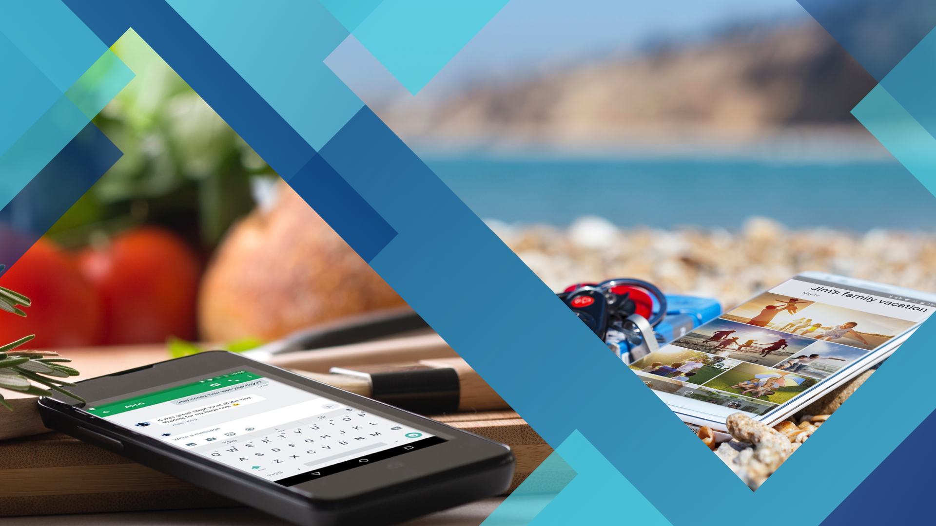

Slide 11
MICRO-MOMENTS

Slide 12
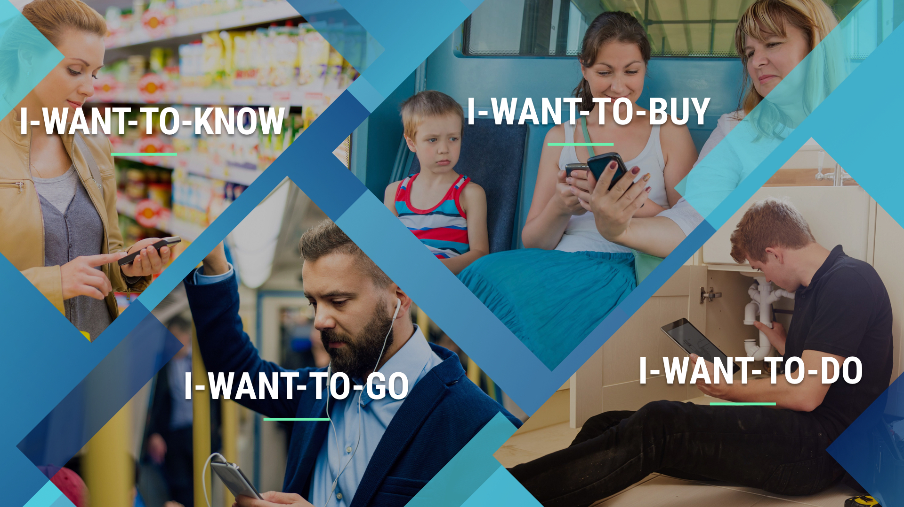

Slide 14
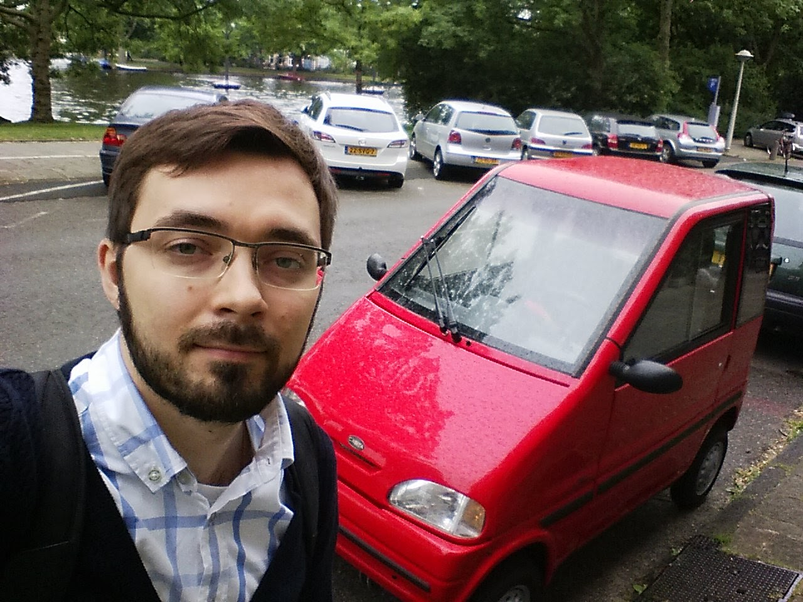

Slide 15
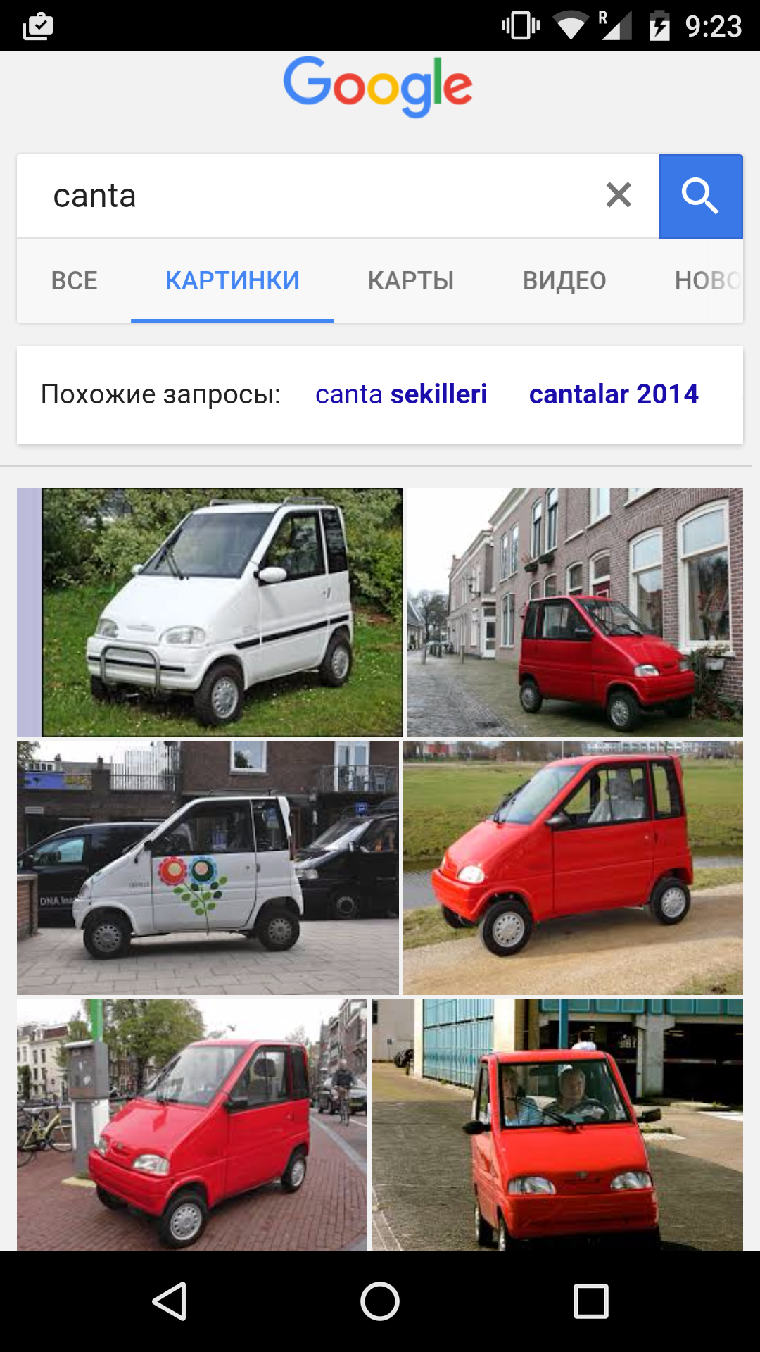

Slide 17
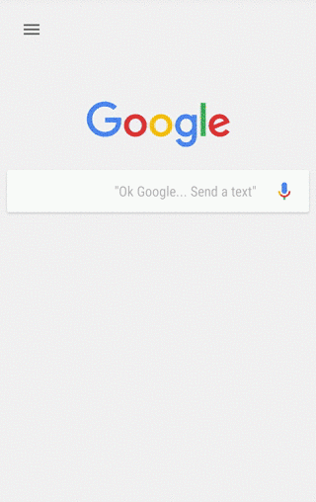

Slide 18
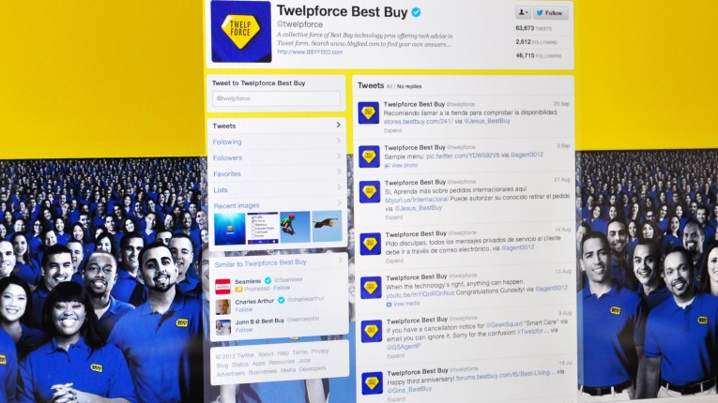

Slide 21
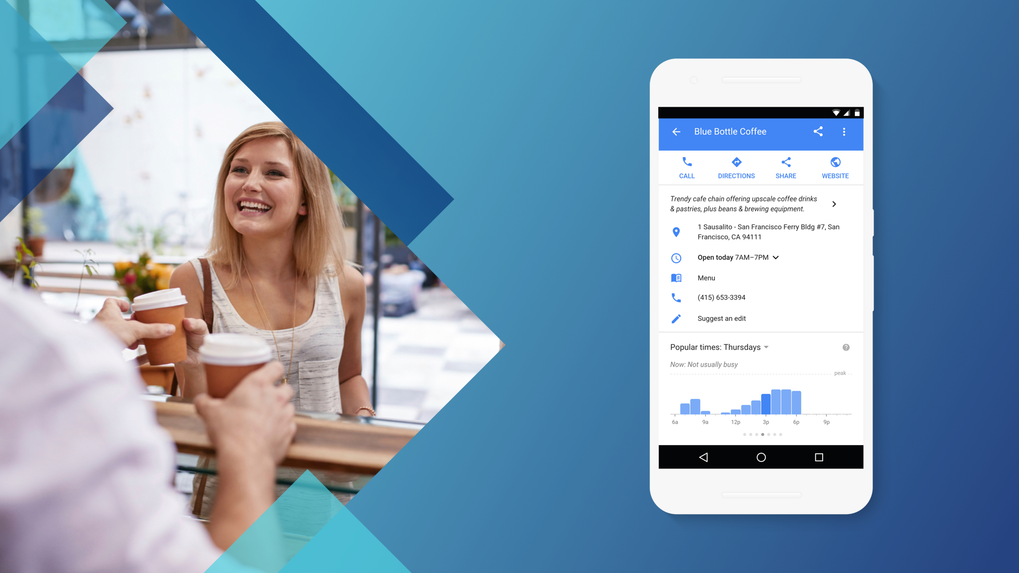

Slide 22
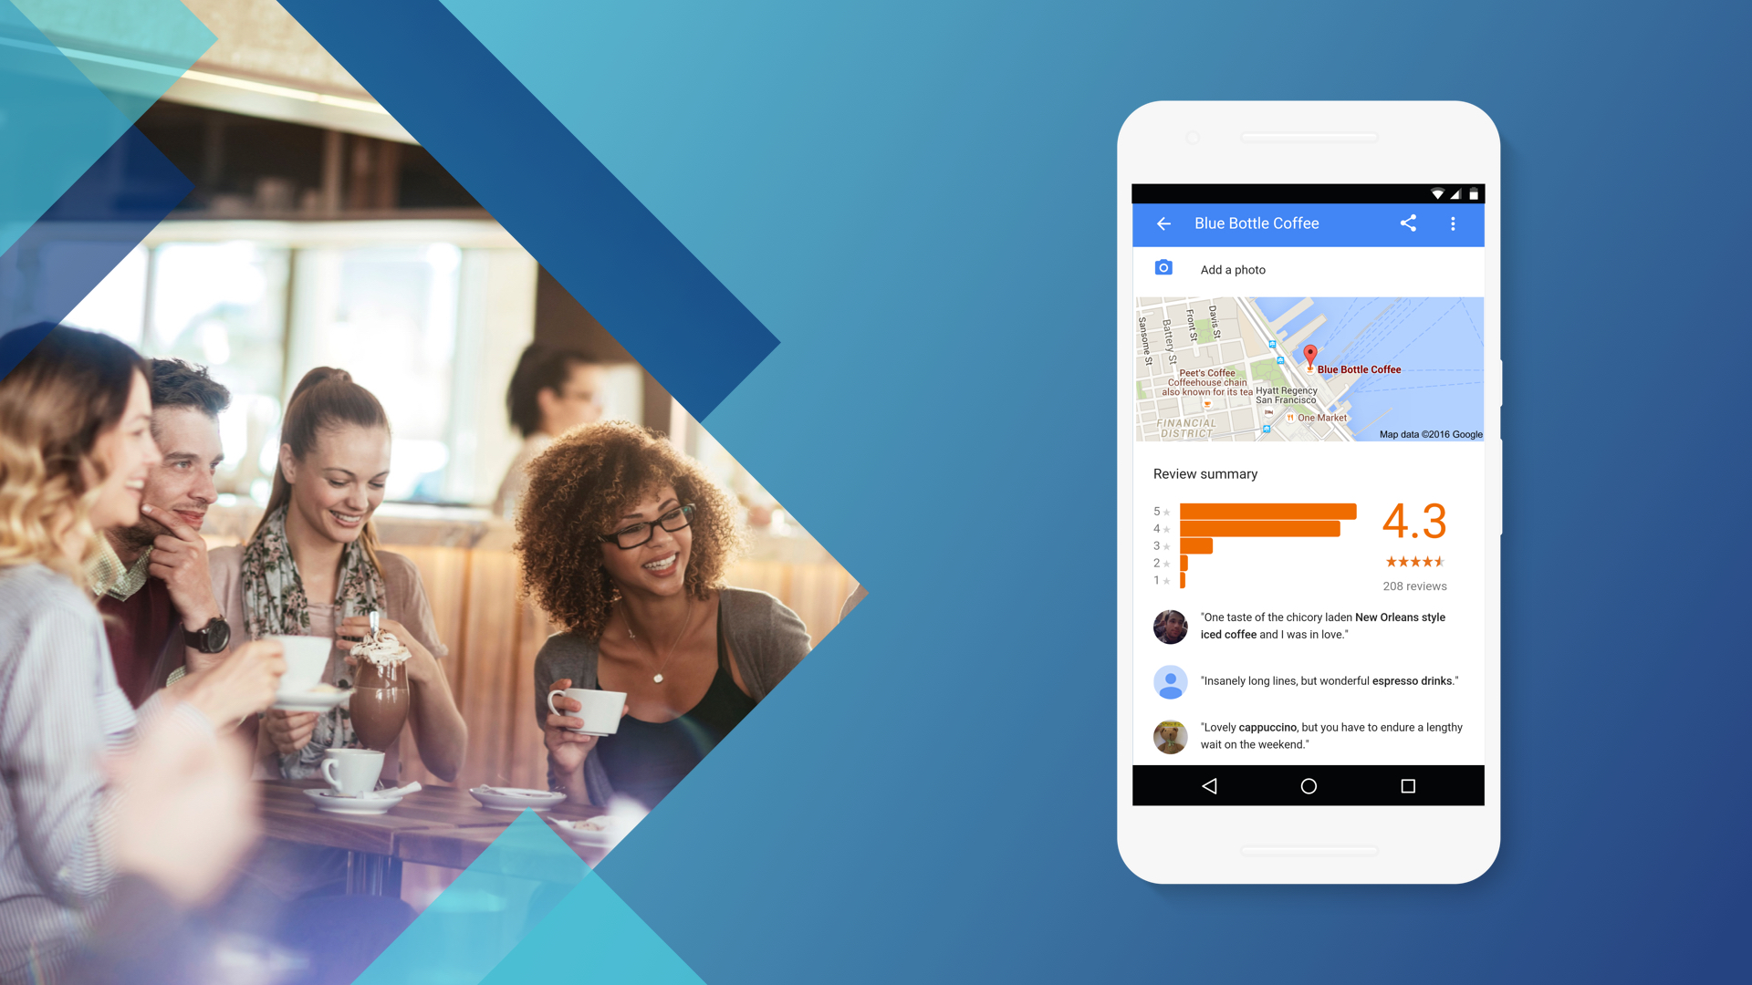

Slide 23
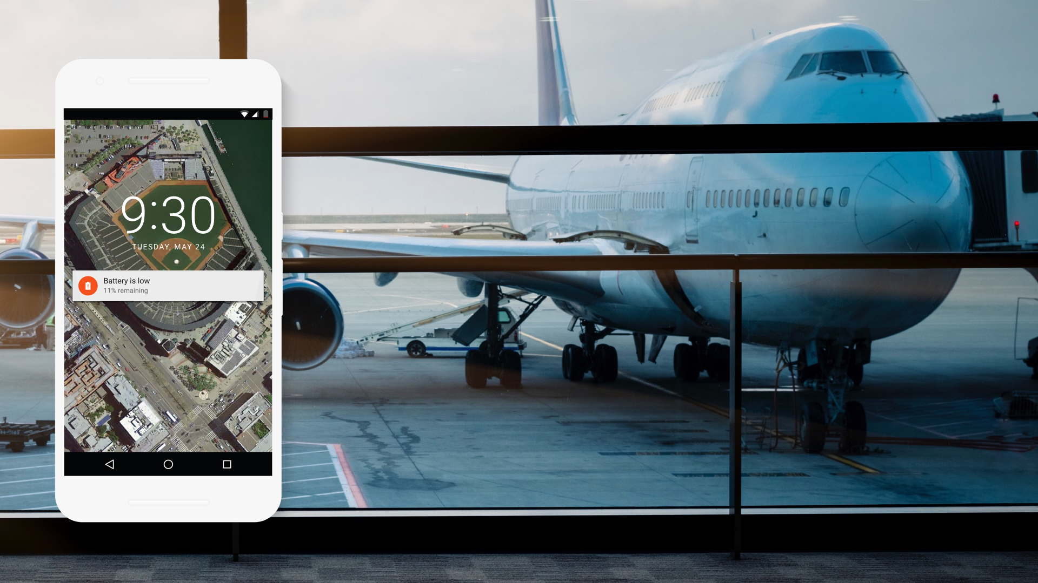

Slide 24
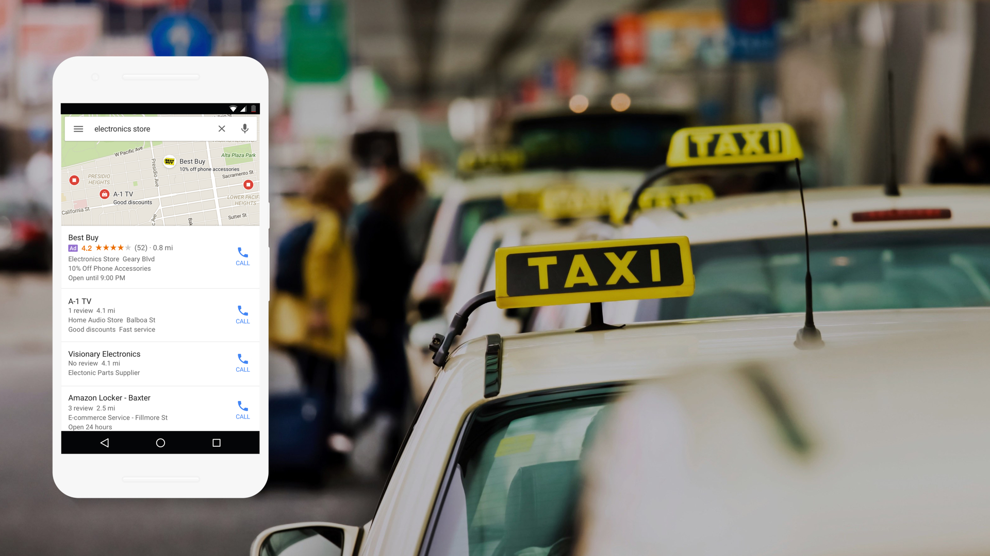
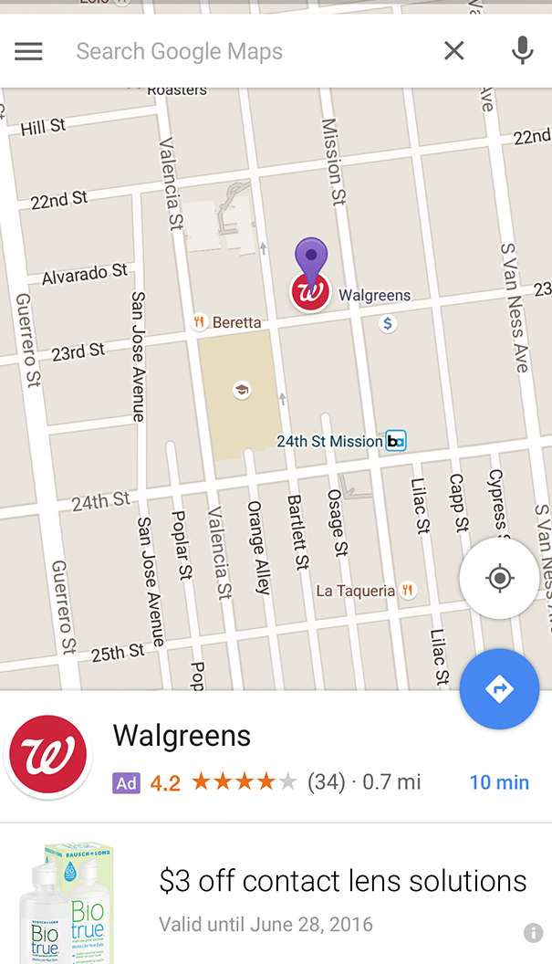

Slide 25
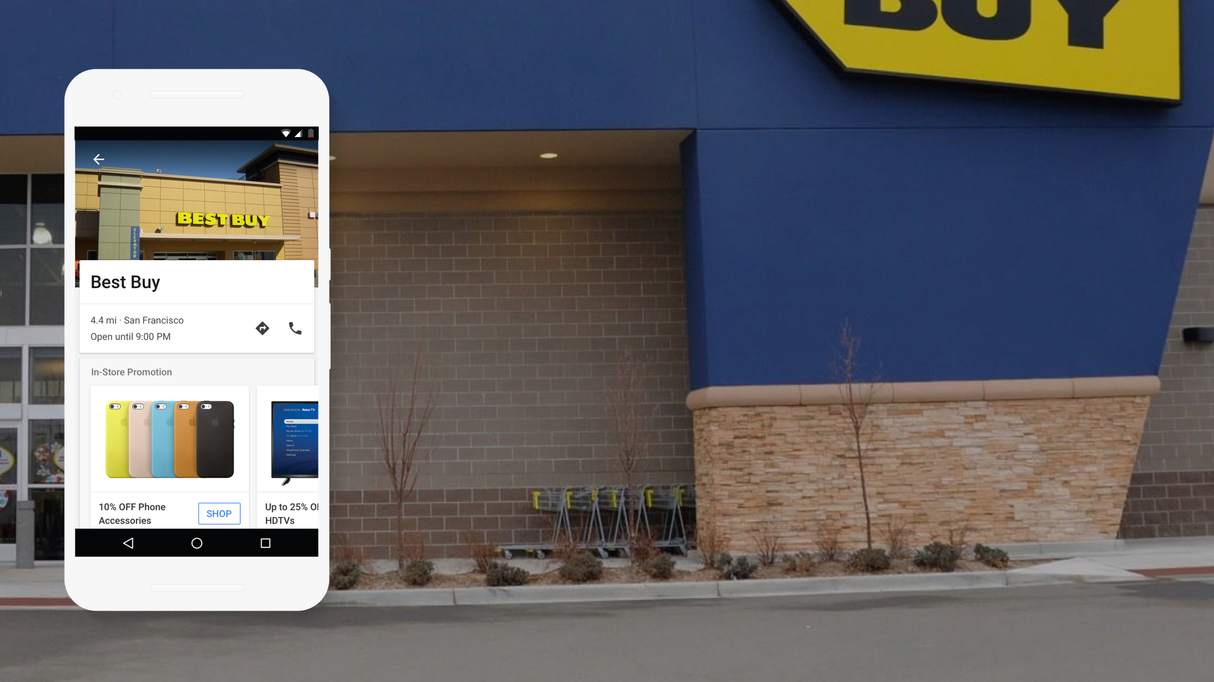

Slide 28
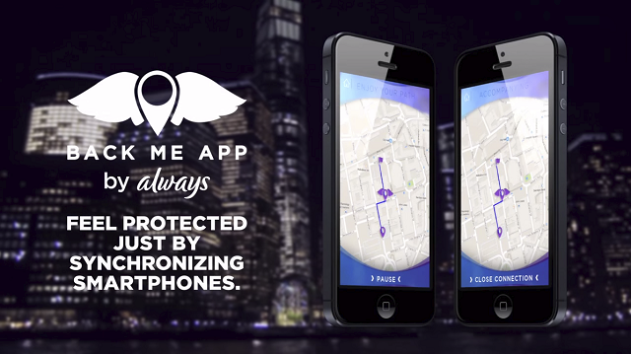

Slide 29
Mobile technology offers
Immersive storytelling

Slide 30
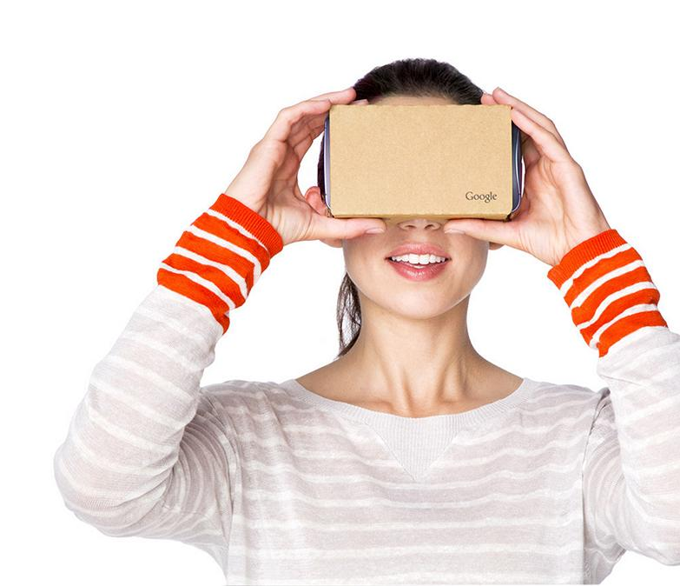
Cardboard
Notes:
Virtual Reality for all.
An improved cardboard experience and new development tools.
The new Cardboard is getting bigger and simpler.
////////////////
Fits devices as large as 6 inches.
Magnet has gone.
New button that works with any phones - capacitive strip.
///////////
Easy setup: 3 steps only vs 16 before.

Slide 31
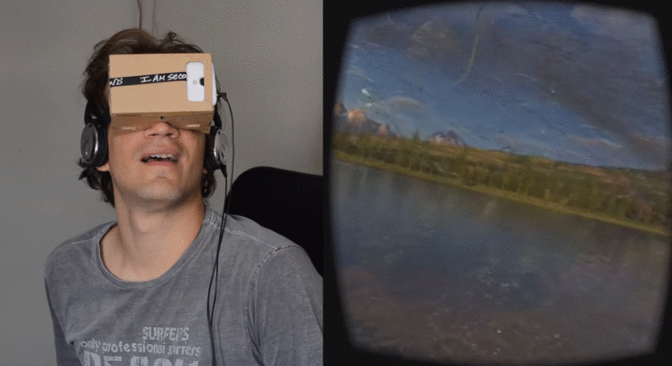
Transport users into virtual dreams
Notes:
http://vrse.works/

Slide 33
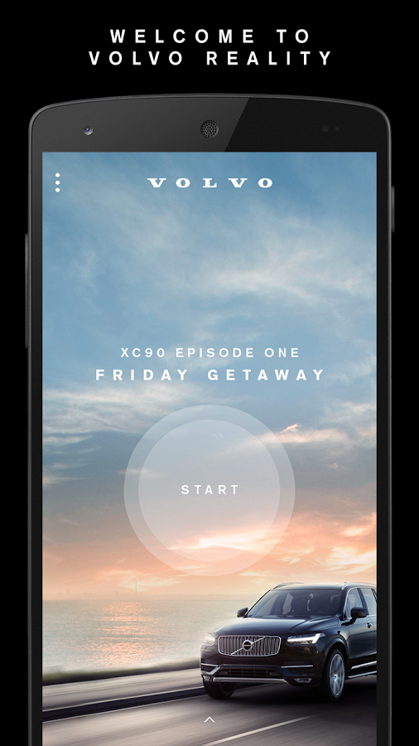
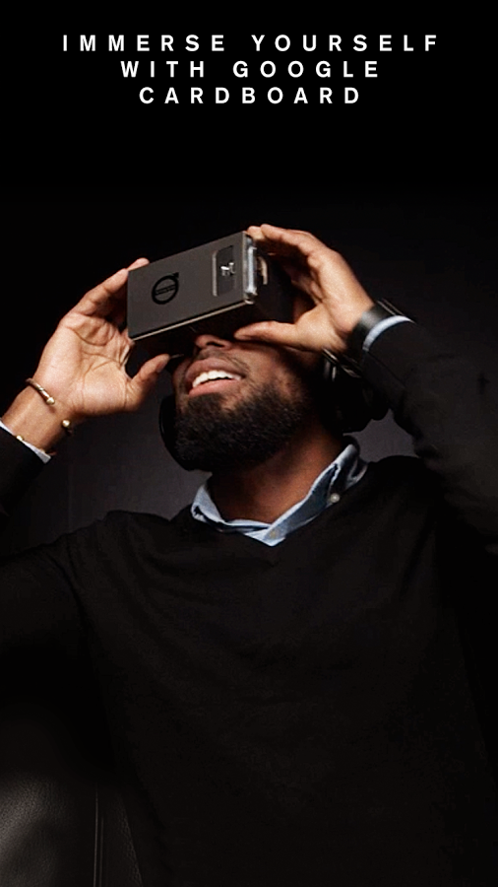

Slide 34
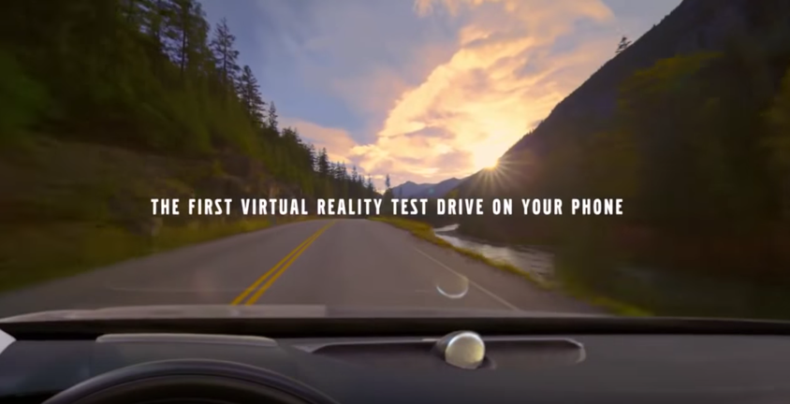

Slide 35
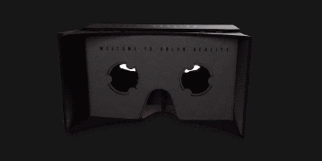

Slide 36
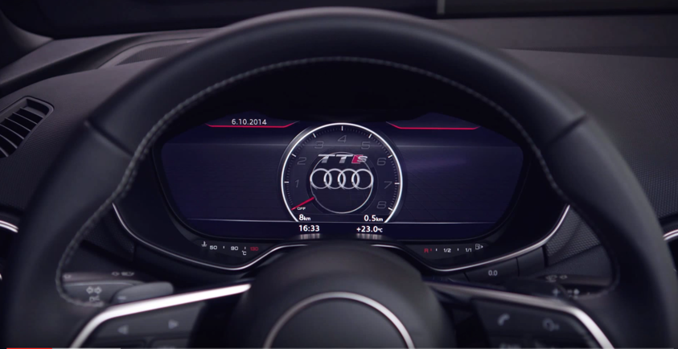

Slide 37
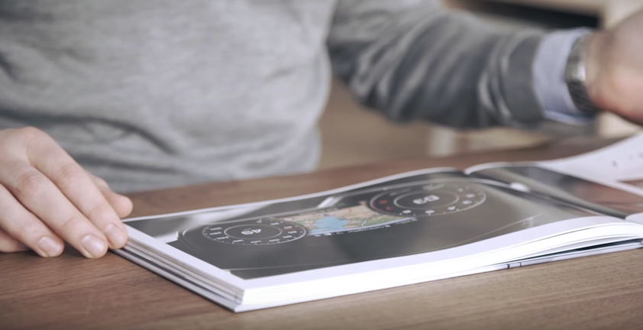

Slide 38
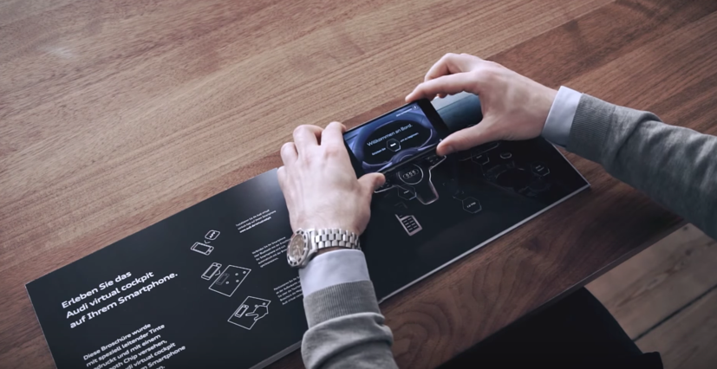

Slide 39
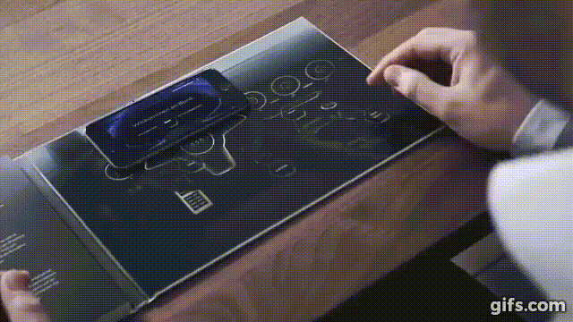

Slide 40
Спасибо!

Slide 41
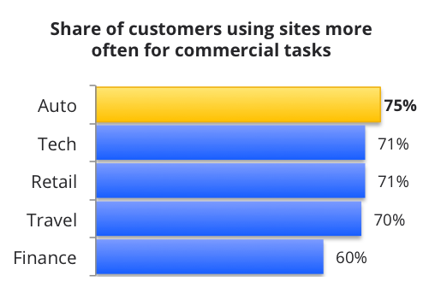
Shoppers mostly spend time in mobile web during their research
Total time spent on mobile devices
Primary channel for commercial tasks
Time spent on sites
10%
10%
66%
Sites Only
90%
31%
social
Time spent on apps
34%
other
35%
gaming & ent.
28%
Sites & Apps
6%
Apps Only

